Slide 1
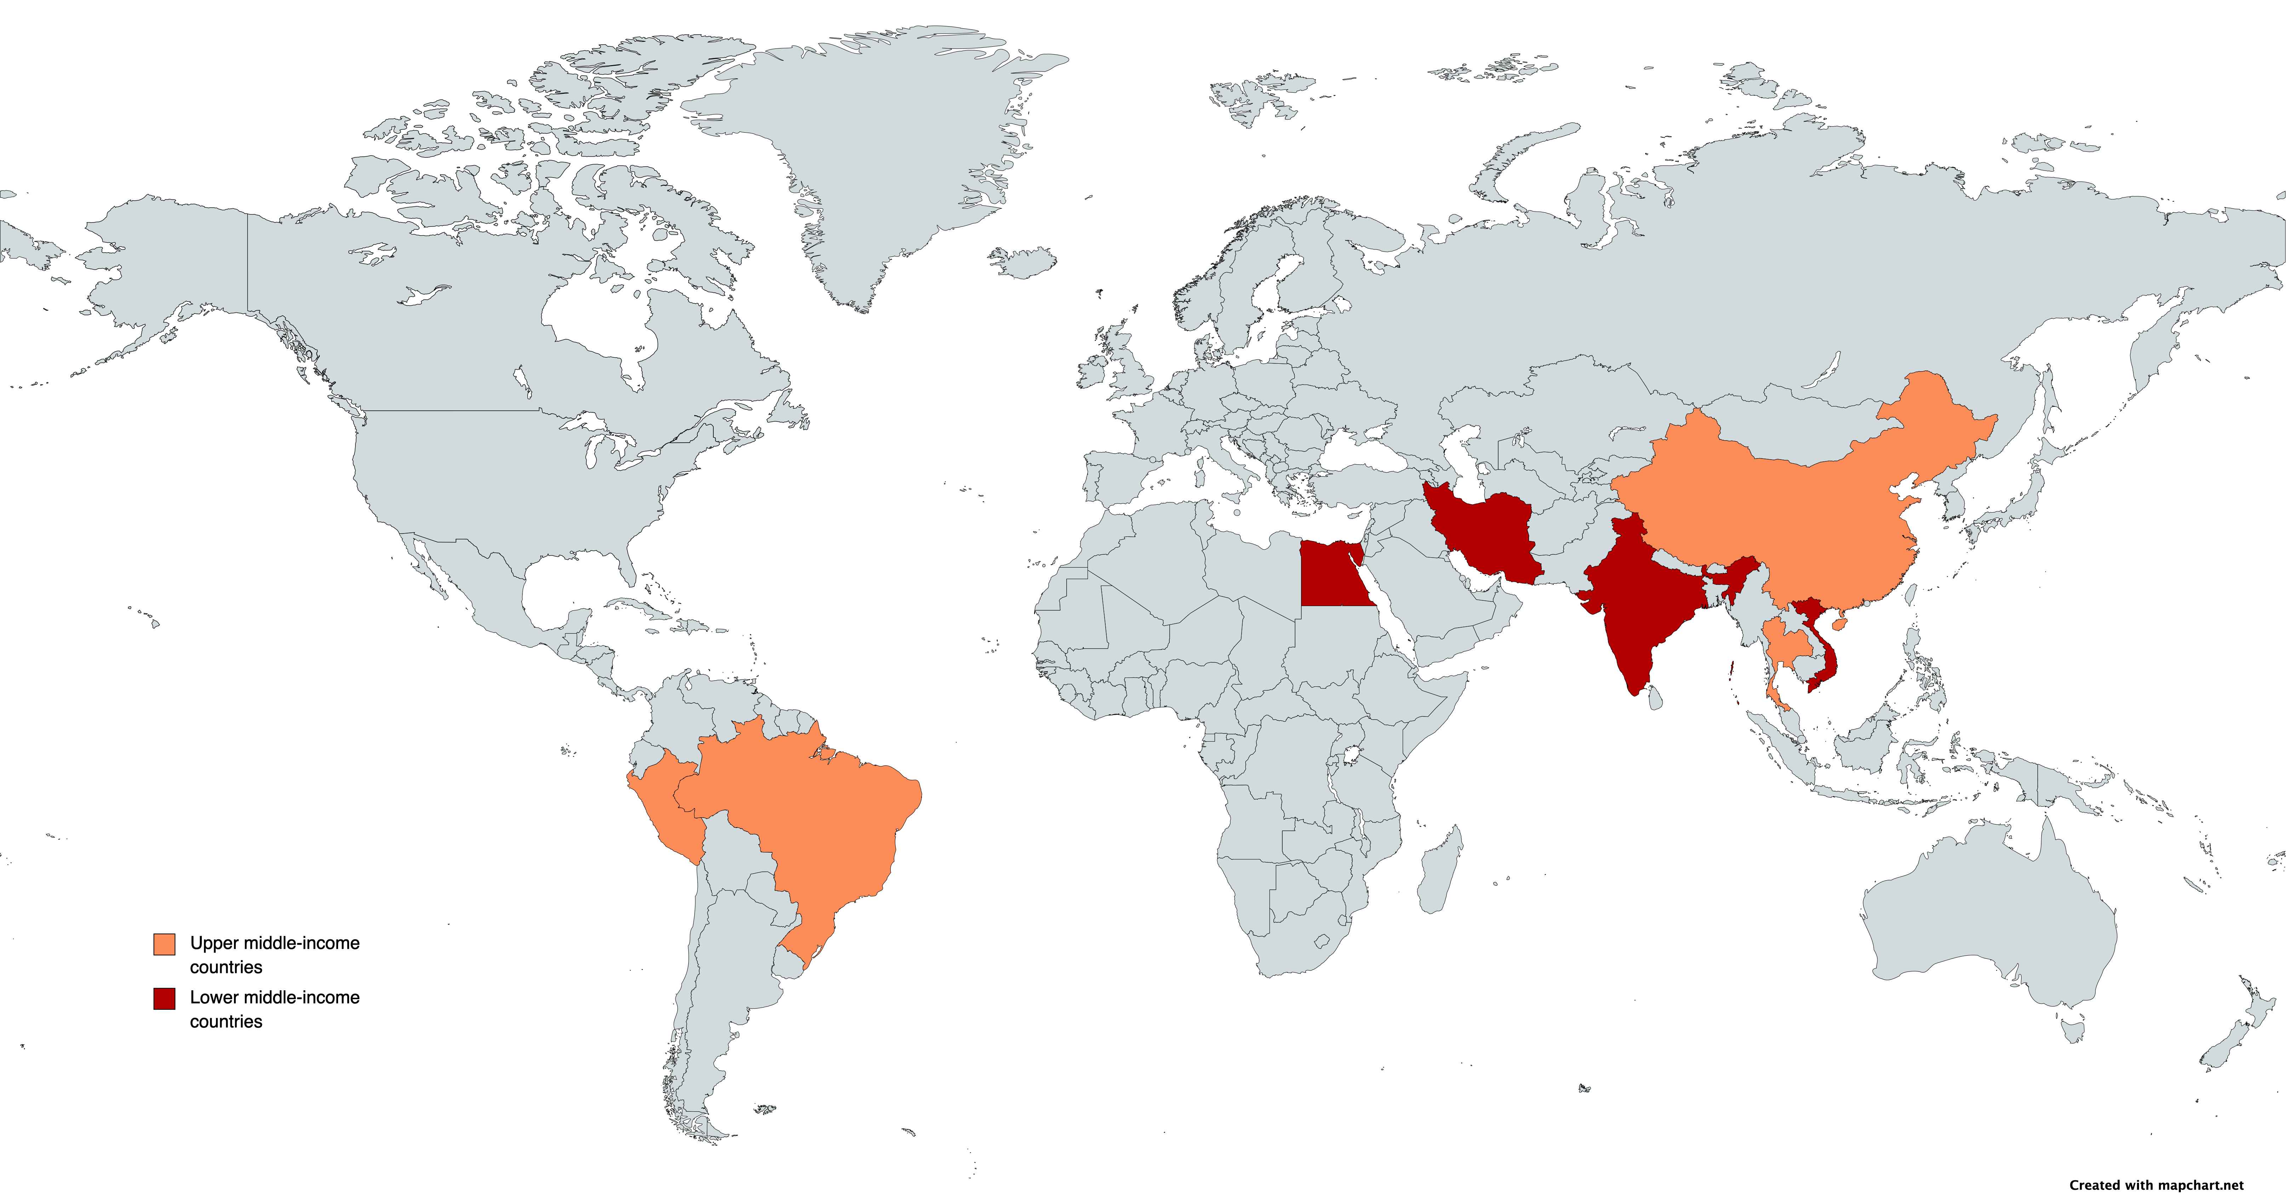
Iran
6 trials
China
12 trials
Egypt
1 trial
India
2 trials
Vietnam
1 trial
Brazil
1 trial
Thailand
1 trial
Peru
1 trial

